Slide 1

Project Title - Car Market Trends Analysis with Car Dekho Data
NAME : C MOHAN RAAJ
AICTE STU ID : STU682c0ae6bea981747716838

Slide 2

PROBLEM STATEMENT
Used-car pricing is influenced by many interacting factors — how new the car is, how much it originally cost, how far it has been driven, what fuel it runs on, who is selling it, and how many previous owners it has had.
Without systematic analysis, it is difficult for buyers or sellers to know which factors matter most, and by how much.
This project investigates a CarDekho used-car dataset (301 listings) to answer that question quantitatively using EDA, correlation analysis, and statistical testing.

Slide 3
Project Description
Car Market Trends Analysis is a Python-based data analysis project using CarDekho used-car data. It analyzes factors such as present price, selling price, car age, kilo-meters driven, fuel type, seller type, transmission, and ownership to identify resale-price patterns and key market trends.
The project uses data cleaning, feature engineering, exploratory data analysis, statistical analysis, and visualization to generate meaningful insights that can support better buying, selling, and dealership decisions.

Slide 4

WHO ARE THE END USERS?
Buyers — can compare a listing's asking price against the two strongest price drivers found in this analysis (present price and car age) before making a purchase decision.
Sellers — can set realistic resale price expectations, understanding that cars in this dataset lose an average of 36.6% of their present price by the time of resale.
Dealers — can prioritize sourcing of vehicle segments (e.g., diesel, automatic, lower present-price-to-age depreciation) that show better average resale value in this dataset.

Slide 5

Technology Used
  Python — core programming language used for the analysis
Pandas & NumPy — data loading, cleaning, and feature engineering
Matplotlib & Seaborn — visualization (histograms, boxplots, scatter, heatmaps, bar charts)
SciPy (stats) — Pearson & Spearman correlation, t-tests, one-way ANOVA
Scikit-learn (optional) & Jupyter Notebook — development environment

Slide 6
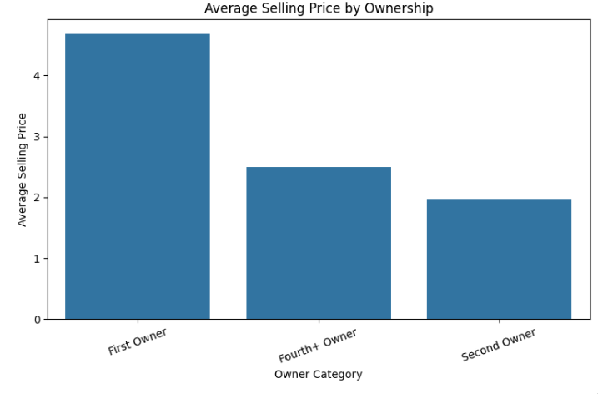
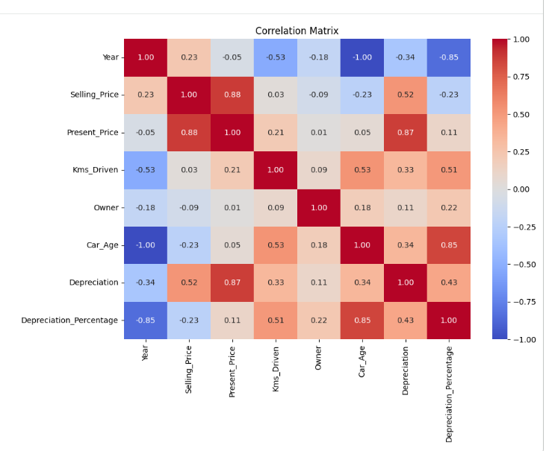
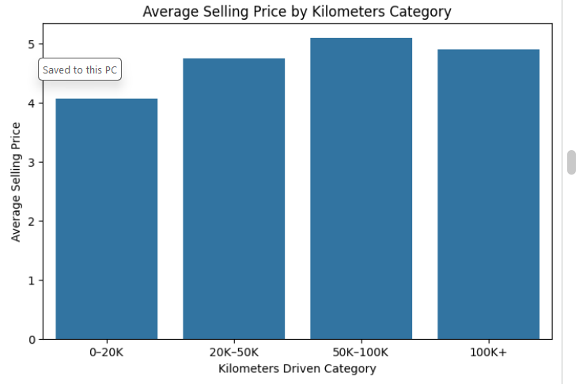
RESULTS
Correlation Matrix of Key Numerical Variables
Demo Link : https://github.com/CMohanRaaj/Car-Market-Trends-Analysis

Slide 7
Thank you
NAME : C MOHAN RAAJ
AICTE ID : STU682c0ae6bea981747716838
COLLEGE : Sathyabama Institute of Science and Technology
.
.

